Slide 1
Data Literacy
Professor Ryan Haas

Slide 2
What is data literacy?
Data literacy:
The ability to read, understand, create, and communicate data.
Enables informed decision-making based on data analysis.
Key concerns:
Understanding data sources and data types.
Understanding the context in which data is used.
Accurately interpreting trends and behaviors and making informed inferences.

Slide 3

Lion moms sometimes eat their cubs when prey is scarce

Slide 4

... The context we use to understand and present data matters

Slide 5
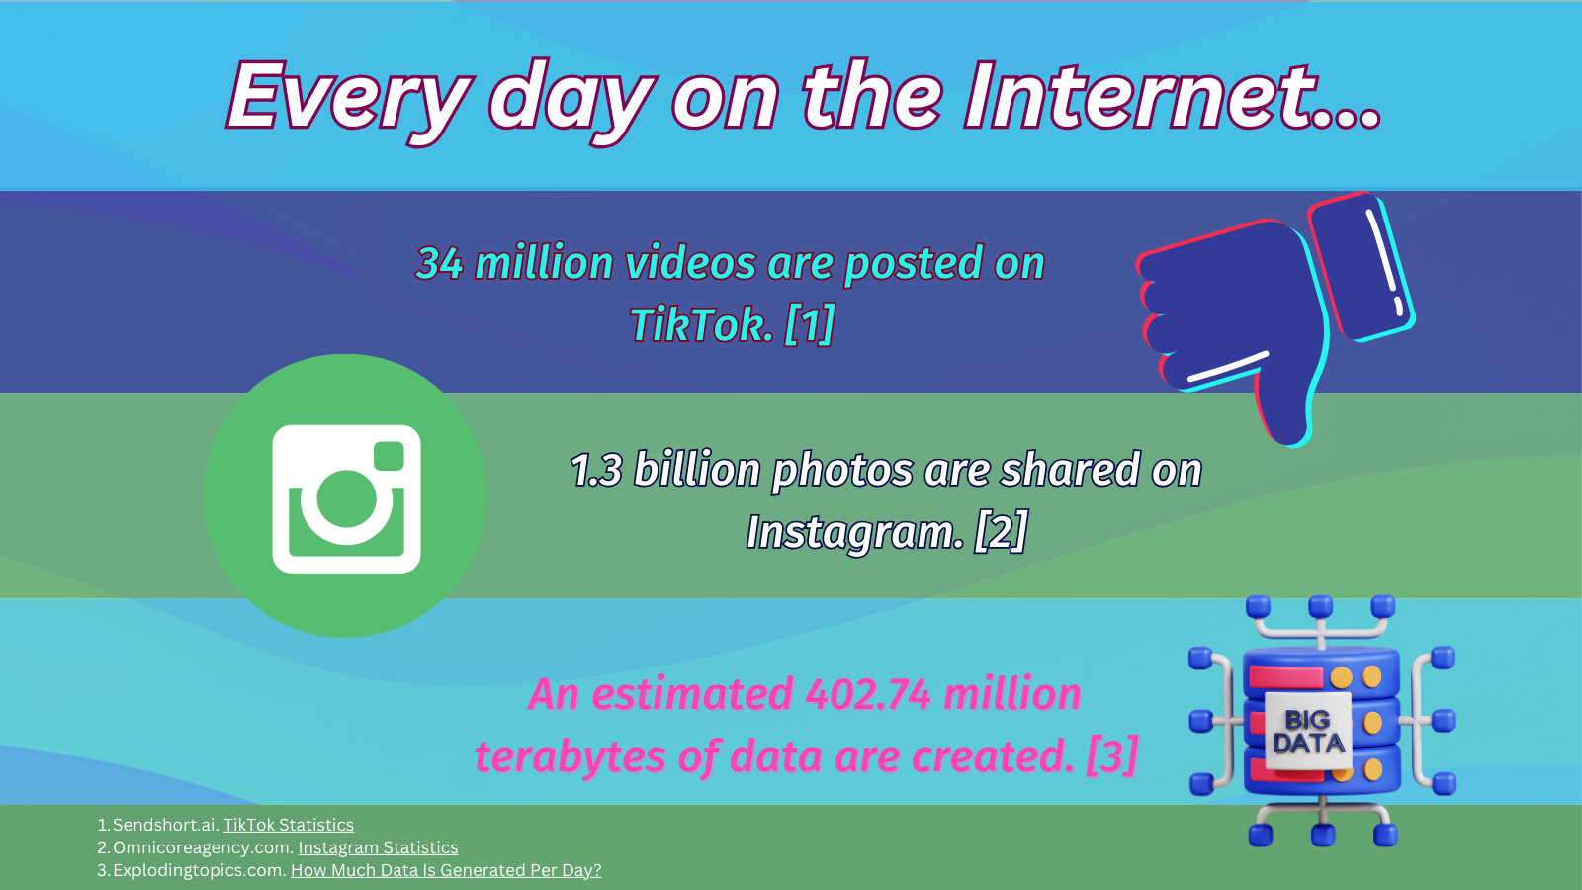
So. Much. Data…
1. Sendshort.ai. TikTok Statistics
2. Omnicoreagency.com. Instagram Statistics
3. Explodingtopics.com. How Much Data Is Generated Per Day?

Slide 6

Defining Data

Slide 7
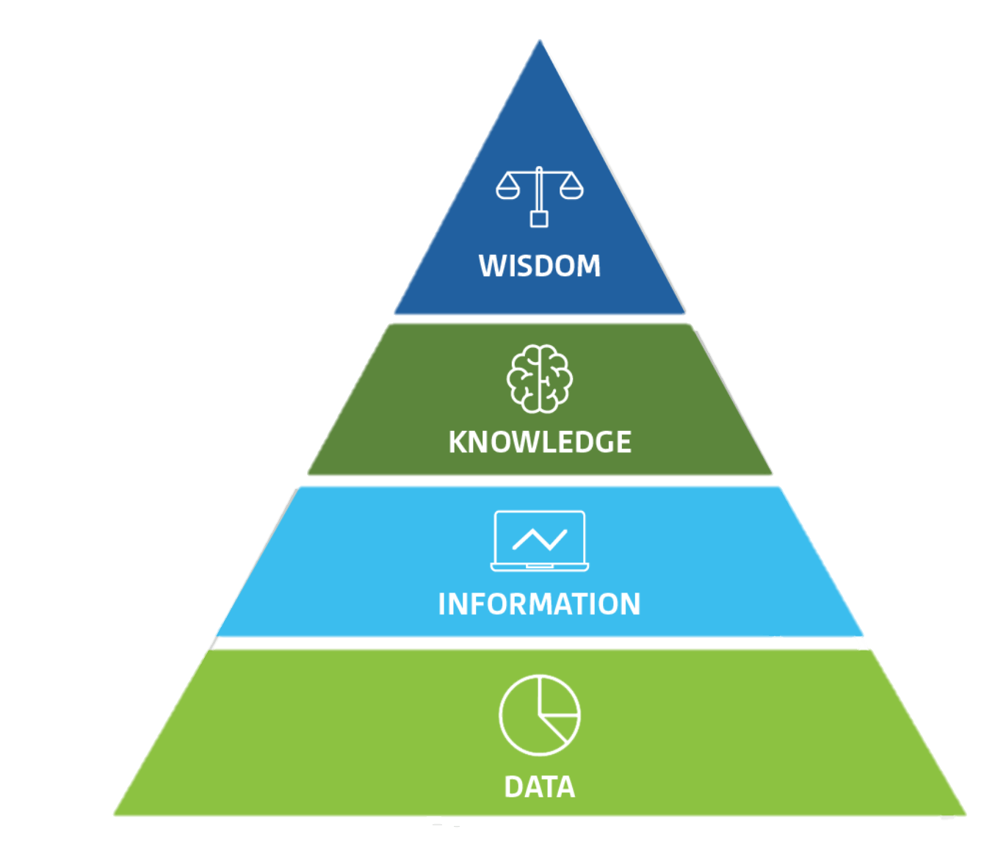
Defining data
Data Definitions:
1. Values representing a specific concept or concepts. [1]
2. “raw figures, numbers, or text that serve as the starting point of analysis.” [2]
Data becomes information when we analyze it and possibly combine it with other data to derive meaning and context. [1]
[1] Data.gov. Glossary: Data vs. information.
[2] Kalé Nitin and Nancy Jones (2020). Practical Analytics (2nd ed.).
Above: The DIKW model, which we will explore in more detail.

Slide 8


Defining data: Qualitative vs. Quantitative
Qualitative data
Descriptive data that cannot be measured numerically, categories.
Ex.: Opinions, observations, experiences, months, demographic groups.
Quantitative data
Numerical data that can be measured and analyzed statistically.
Ex.: Sales figures, test scores, experiment results.

Slide 9



Defining data: Qualitative, Quantitative – What’s the use?
Qualitative
Quantitative
Combining both!?
Allows for rich, in-depth insights into behaviors, attitudes and experiences.
Allows for statistical analysis, trend identification, and data-driven decision-making.
Allows for deeper, more comprehensive understanding of a topic.

Slide 10


Defining data: Structured vs. unstructured
Structured data
Typically quantitative—highly organized (standard formats).
Ex.: Dates, names, addresses, credit card numbers.
Unstructured data
Typically qualitative—lacks a predefined format.
Ex.: text and social media posts, Internet of Things (IoT) sensor data.
IBM (2021). Structured vs unstructured data.

Slide 11

Visualizing Data

Slide 12
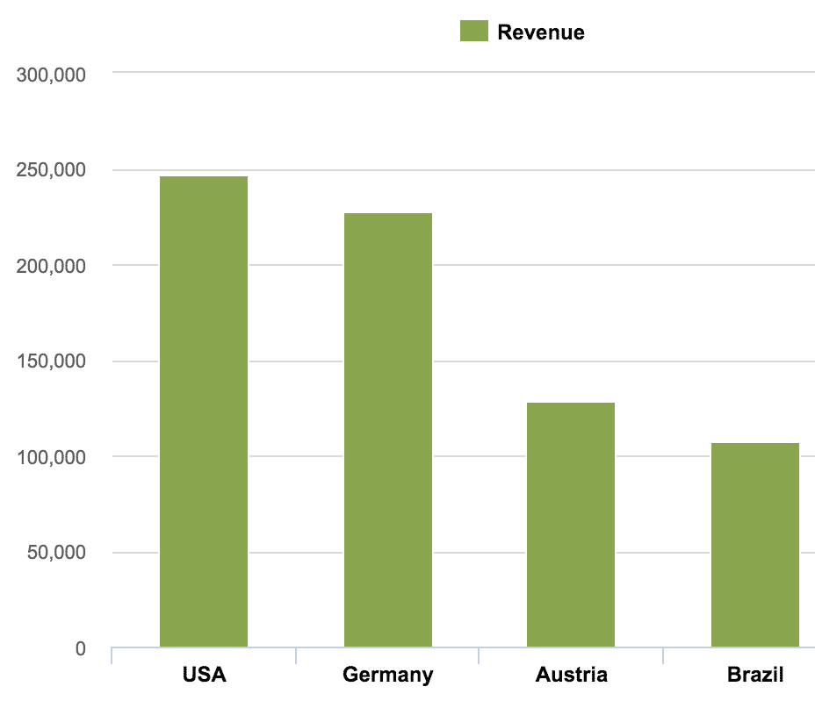
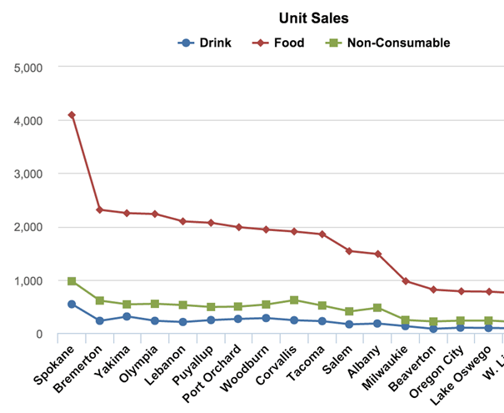
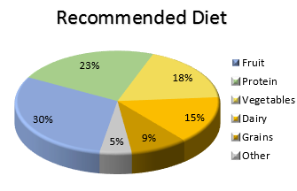
Common chart types
Column/bar Chart
Compare values for different categories or compare value changes over a period of time for a single category.
Pie Chart
Visualize parts of a whole (percentages), when comparing exact values is not the goal.
Line Chart
Emphasize the continuation/flow of values (trends) over time (time series data).

Slide 13
When to use different chart types
Column/bar Chart
Best for: Comparing values across categories.
Dos and Don’ts:
Start the numerical axis at zero! Our eyes are sensitive to height.
Don’t use for more than 5-7 categories.
If you represent time, always put it on the x-axis. Progress from left to right.
Pie Chart
Best for: Showing proportional relationship of parts of a whole.
Dos and Don’ts:
Ensure the sum of the segments is 100 percent.
Don’t use for more than 5 categories, ideally, only two categories E.g., men compared to women; market share and compared to whole market.
Don’t use a pie chart if category values are very similar or completely unrelated.
Line Chart
Best for: Showing trends over time.
Dos and Don’ts:
Typically, start the axis at zero.
Don’t skip values for consistent data intervals that present trend information. E.g., don’t skip days with zero values.
Once again, time goes on the x-axis and should progress from left to right.

Slide 14

(Mis) Interpreting Charts

Slide 15
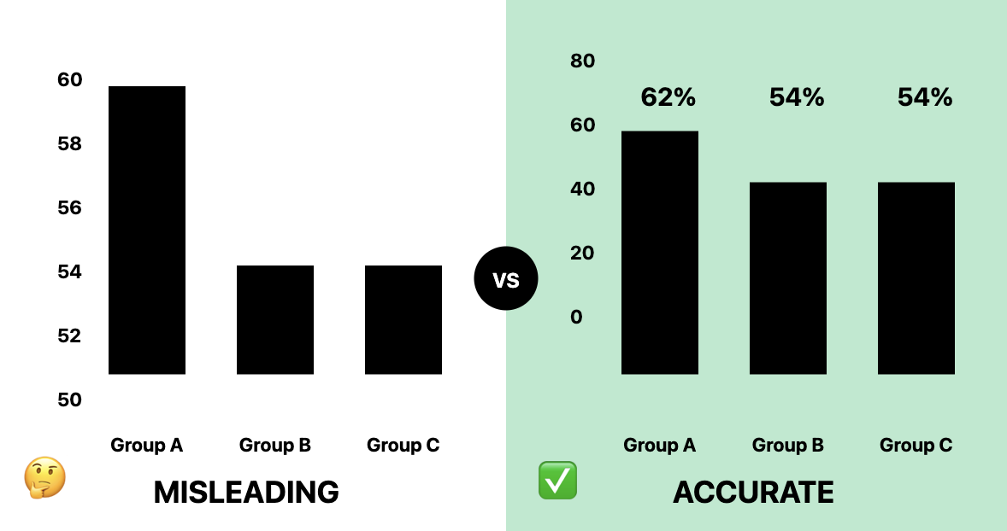
Misleading charts: Omitting the Baseline
Starting with a vertical axis at 50 stretches the trend making the difference among the groups seem massive.
We are only looking at an 8% difference!

Slide 16
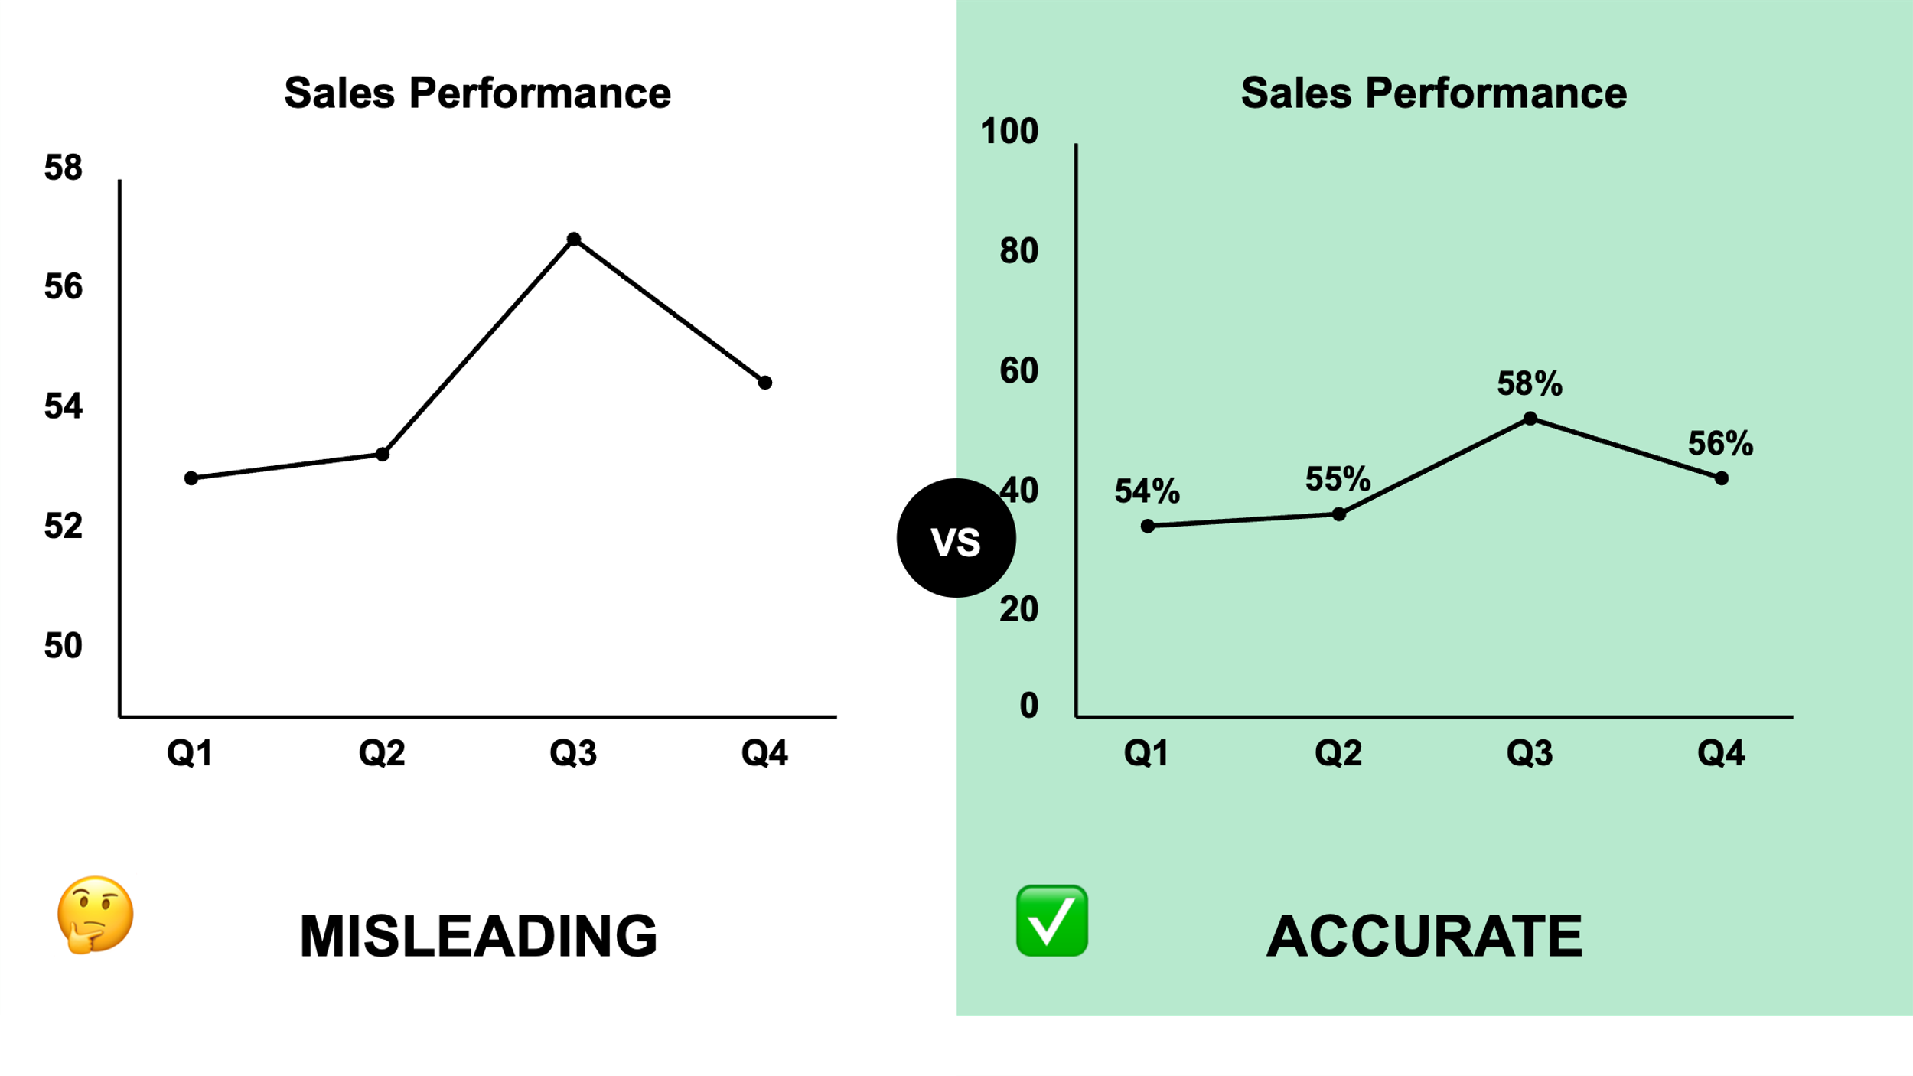
Misleading charts: Manipulating the y-axis
This time, the trick is not removing the baseline but using the scale to make the performance look steeper.
So we could exaggerate a spike if or flatten it, depending on what we were trying to “sell”.

Slide 17
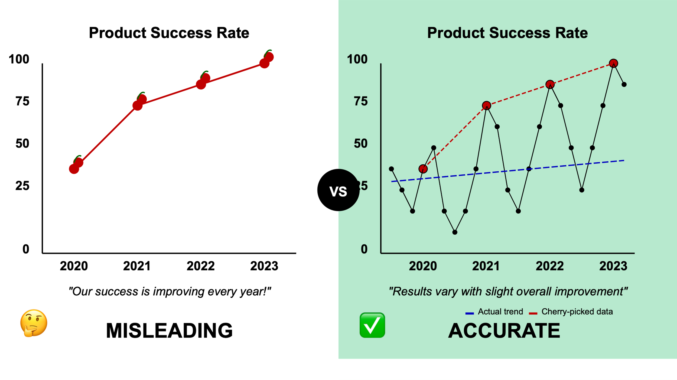
Misleading charts: Cherry-picking
4 carefully selected data points: strong upward trend.
Doesn’t quite resemble the average shown by our linear regression (blue) trendline, does it?

Slide 18
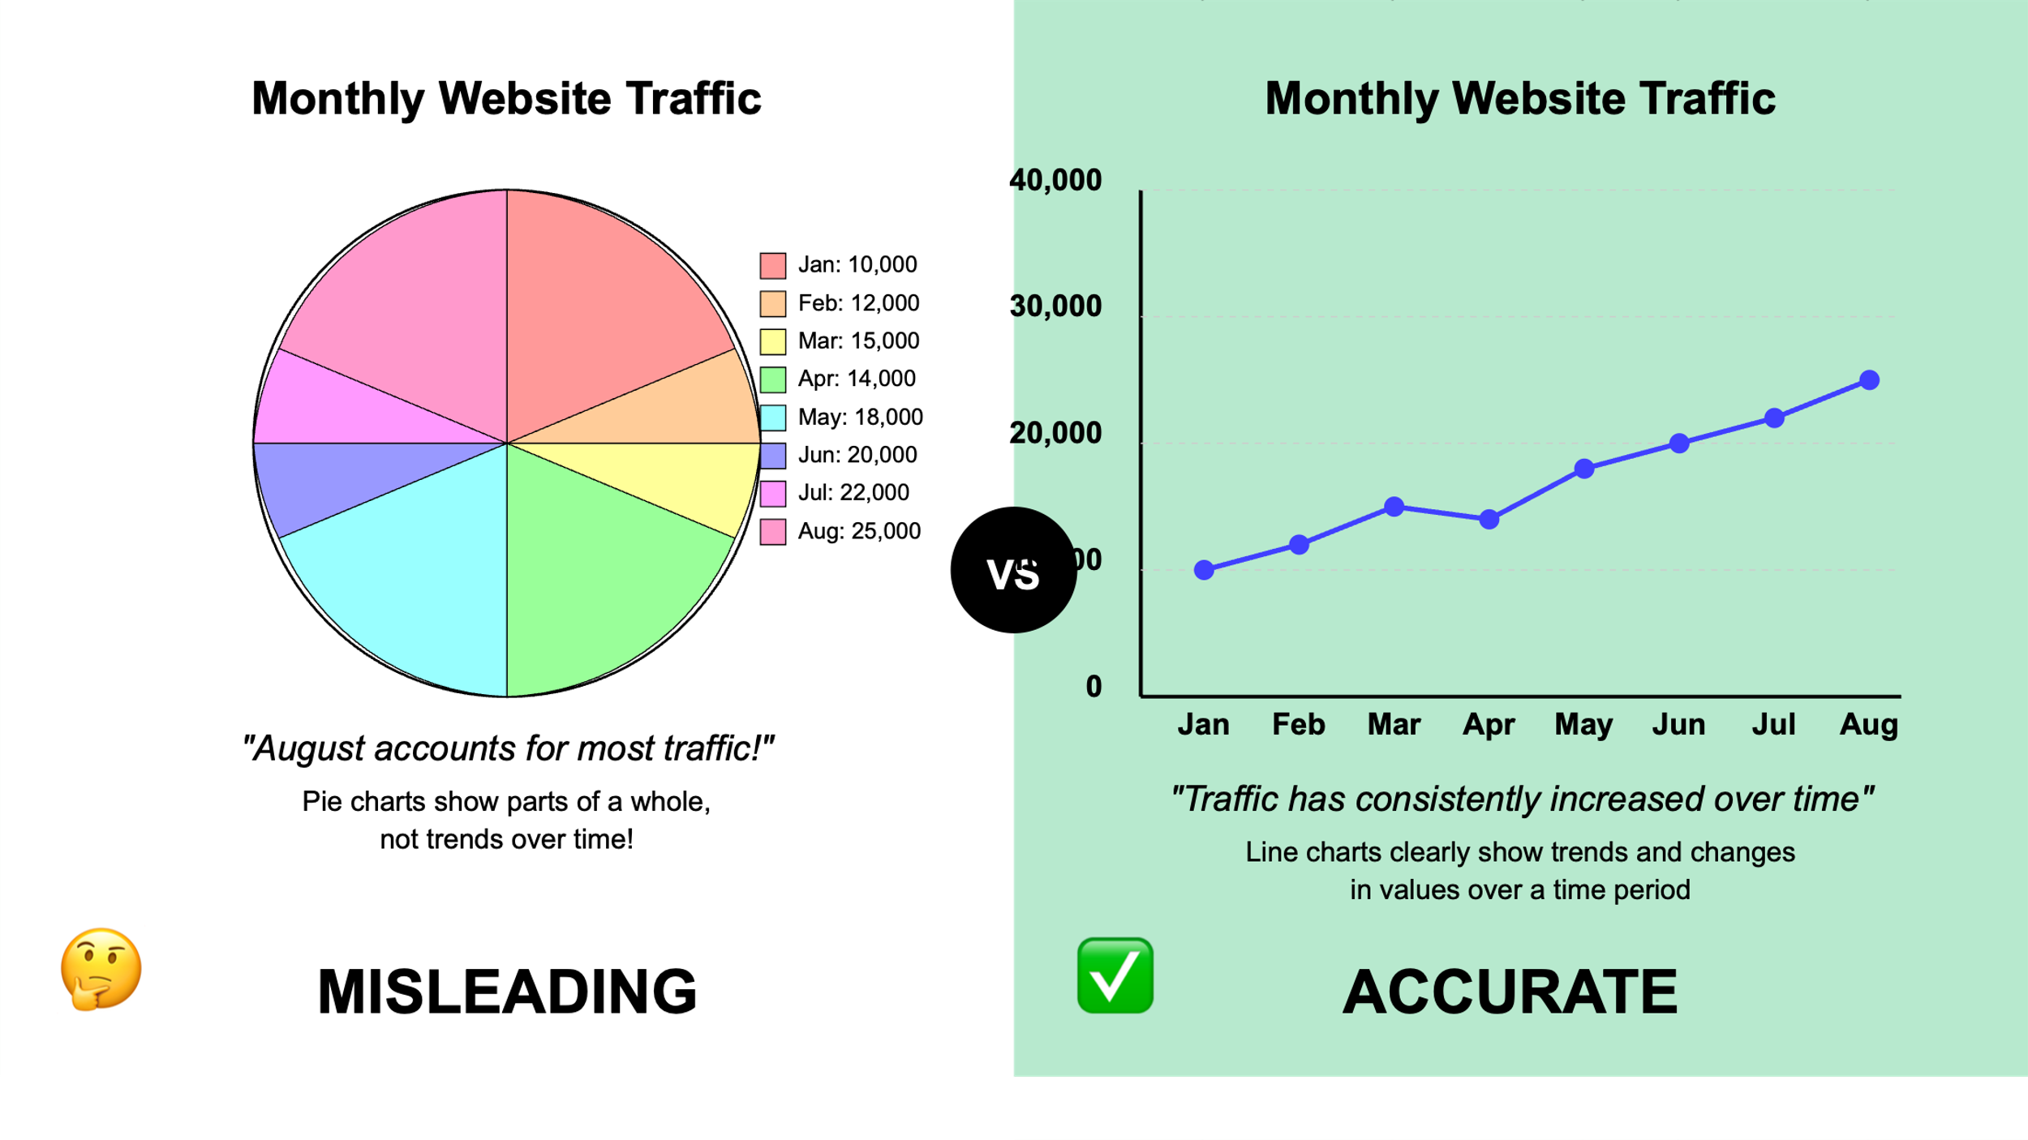
Misleading charts: Wrong chart type!
August does account for most traffic, but you wouldn’t know it by looking at the pie chart on the left.
A trend over time should be represented with a line chart!

Slide 19
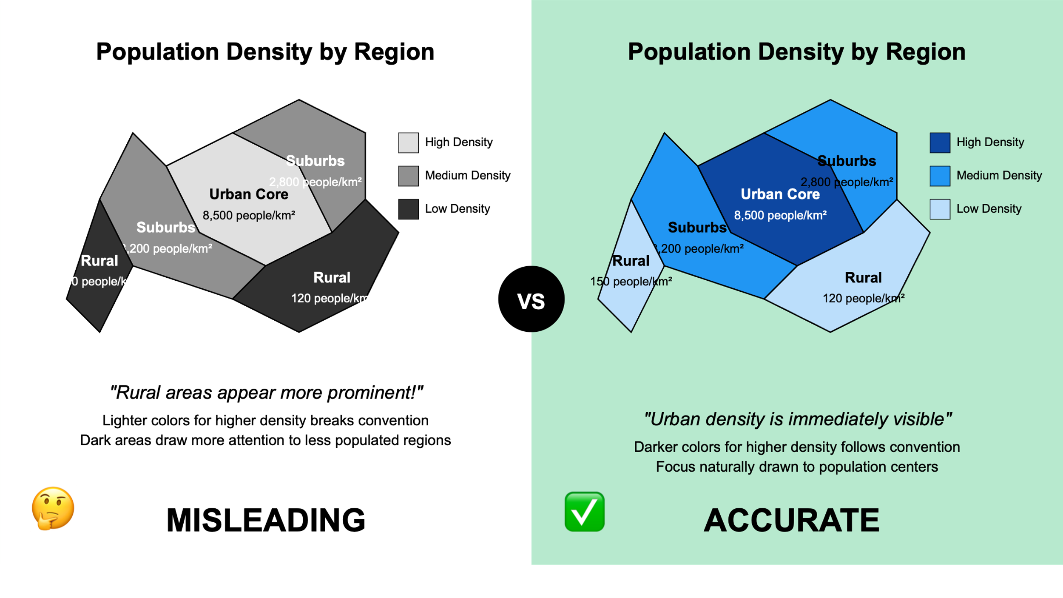
Misleading charts: Wrong chart type!
Convention:
lower value = greater density
higher value = lesser density
Can’t help but perceive the rural areas as most dense, urban areas as least.
We love when you’re creative, just not with your charts 😉

Slide 20

The Big Picture

Slide 21
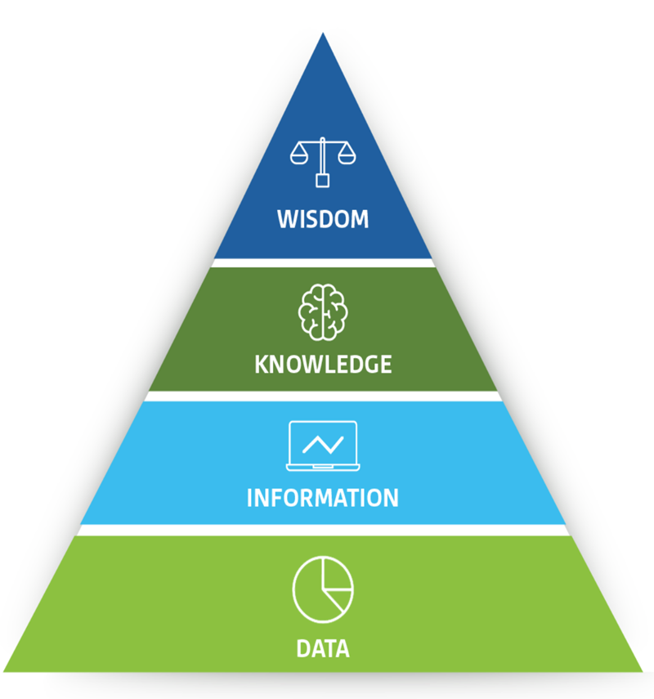
The big picture: Why we care about data
4. Wisdom is, ultimately, a state of awareness. It’s a set of principles by which a person, or organization, will act.
3. Knowledge represents the synthesis of multiple sources of information over time. Knowledge often comes in the form of frameworks and theories.
2. Information sits on top of the data foundation and is attained by providing context to data. Information is gathered via an analytics platform or deciphered by an analytics team which begins to give the data meaning and purpose.
1. Data are the raw figures, numbers, or text that serve as the starting point of analysis.
Above: The DIKW Model
Kalé Nitin and Nancy Jones (2020). Practical Analytics (2nd ed.).

Slide 22
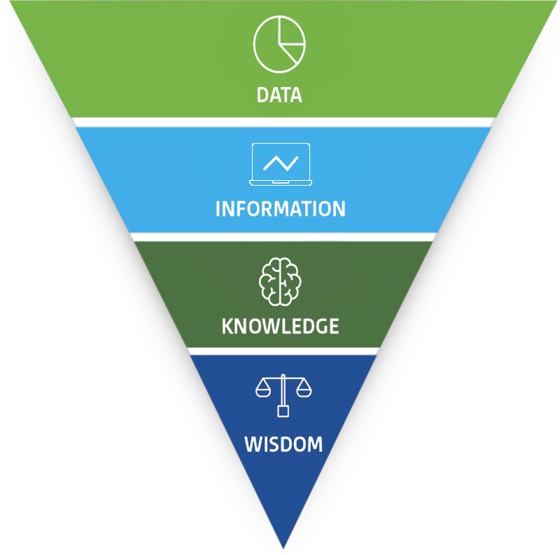
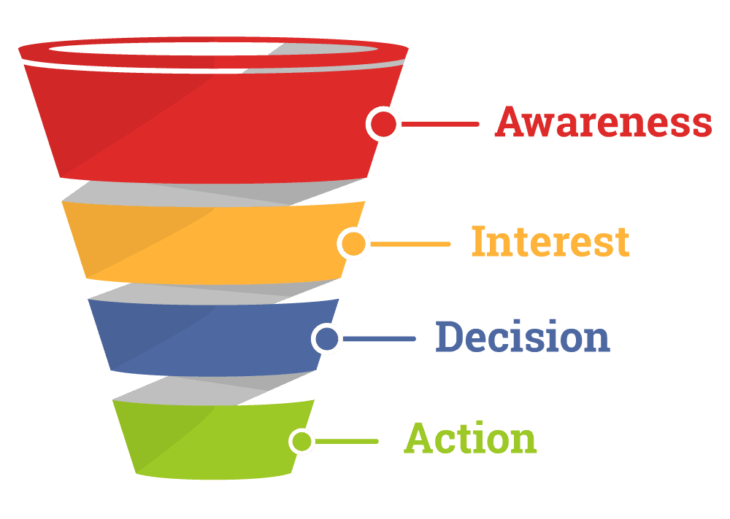
The big picture: A process of synthesis
1. Data are the raw figures, numbers, or text that serve as the starting point of analysis.
2. Information sits on top of the data foundation and is attained by providing context to data.
3. Knowledge represents the synthesis of multiple sources of information over time.
Above: A sales funnel, sometimes divided into more stages.
Similar to how the volume of people diminishes at each stage in sales toward a customer’s action, each level in DIKW is a further abstraction from the original data.
4. Wisdom is, ultimately, a state of awareness. It’s a set of principles.
Kalé Nitin and Nancy Jones (2020). Practical Analytics (2nd ed.).

Slide 23
DIKW scenario: Eggs and milk
When a customer comes to the store to buy eggs and milk, they're seeing the result of this entire DIKW process.
The store's ability to have the right products available at the right time is the culmination of:
data collection,
processing that data into useful information,
applying knowledge to predict demand and manage stock, and…
using wisdom to make strategic decisions that satisfy customer needs while optimizing operations.

Slide 24

DIKW scenario: Data
Raw facts: The grocery store collects data such as:
The number of eggs and milk cartons sold each day.
Dates and times of sales.
Inventory levels.
Delivery schedules.
Customer preferences (e.g., organic vs. conventional products).
External factors like weather reports that might impact shopping habits.

Slide 25

DIKW scenario: Information
Processed data à information: The store processes the raw data to generate:
Sales reports: Summarizing the daily, weekly, or monthly sales of eggs and milk.
Inventory status: Current stock levels and the rate at which they are depleting.
Customer trends: Identifying patterns, such as a higher demand for eggs on weekends or an increased purchase of milk during colder months.
Supplier performance: Tracking the delivery times and quality of shipments from suppliers.

Slide 26

DIKW scenario: Knowledge
Understanding and insights: The store applies knowledge by:
Forecasting demand: Using historical sales data to predict future needs, ensuring that enough eggs and milk are stocked without overstocking.
Stock management: Knowing when to reorder products based on the rate of sale and lead time from suppliers.
Customer behavior: Understanding that promotions or seasonal events (like baking during holidays) might increase demand for eggs and milk.

Slide 27


Examples: Understanding Customer Behavior Matters!
Market Basket Analysis
Optimized store layout + targeted promotions = 💰
Customer Segmentation
Targeted promotions + customer loyalty = 💰

Slide 28

DIKW scenario: Wisdom
Decision-making and strategy: The store uses wisdom to make informed decisions, such as:
Optimizing inventory: Deciding to stock more of certain types of milk (e.g., lactose-free) if customer preferences shift, or adjusting order quantities based on upcoming holidays.
Supplier relationships: Choosing to partner with suppliers who provide the best balance of cost, quality, and reliability to meet customer demands efficiently.
Sustainability practices: Implementing strategies to reduce waste, like using data to track expiration dates and optimize the supply chain, minimizing spoilage.

Slide 29
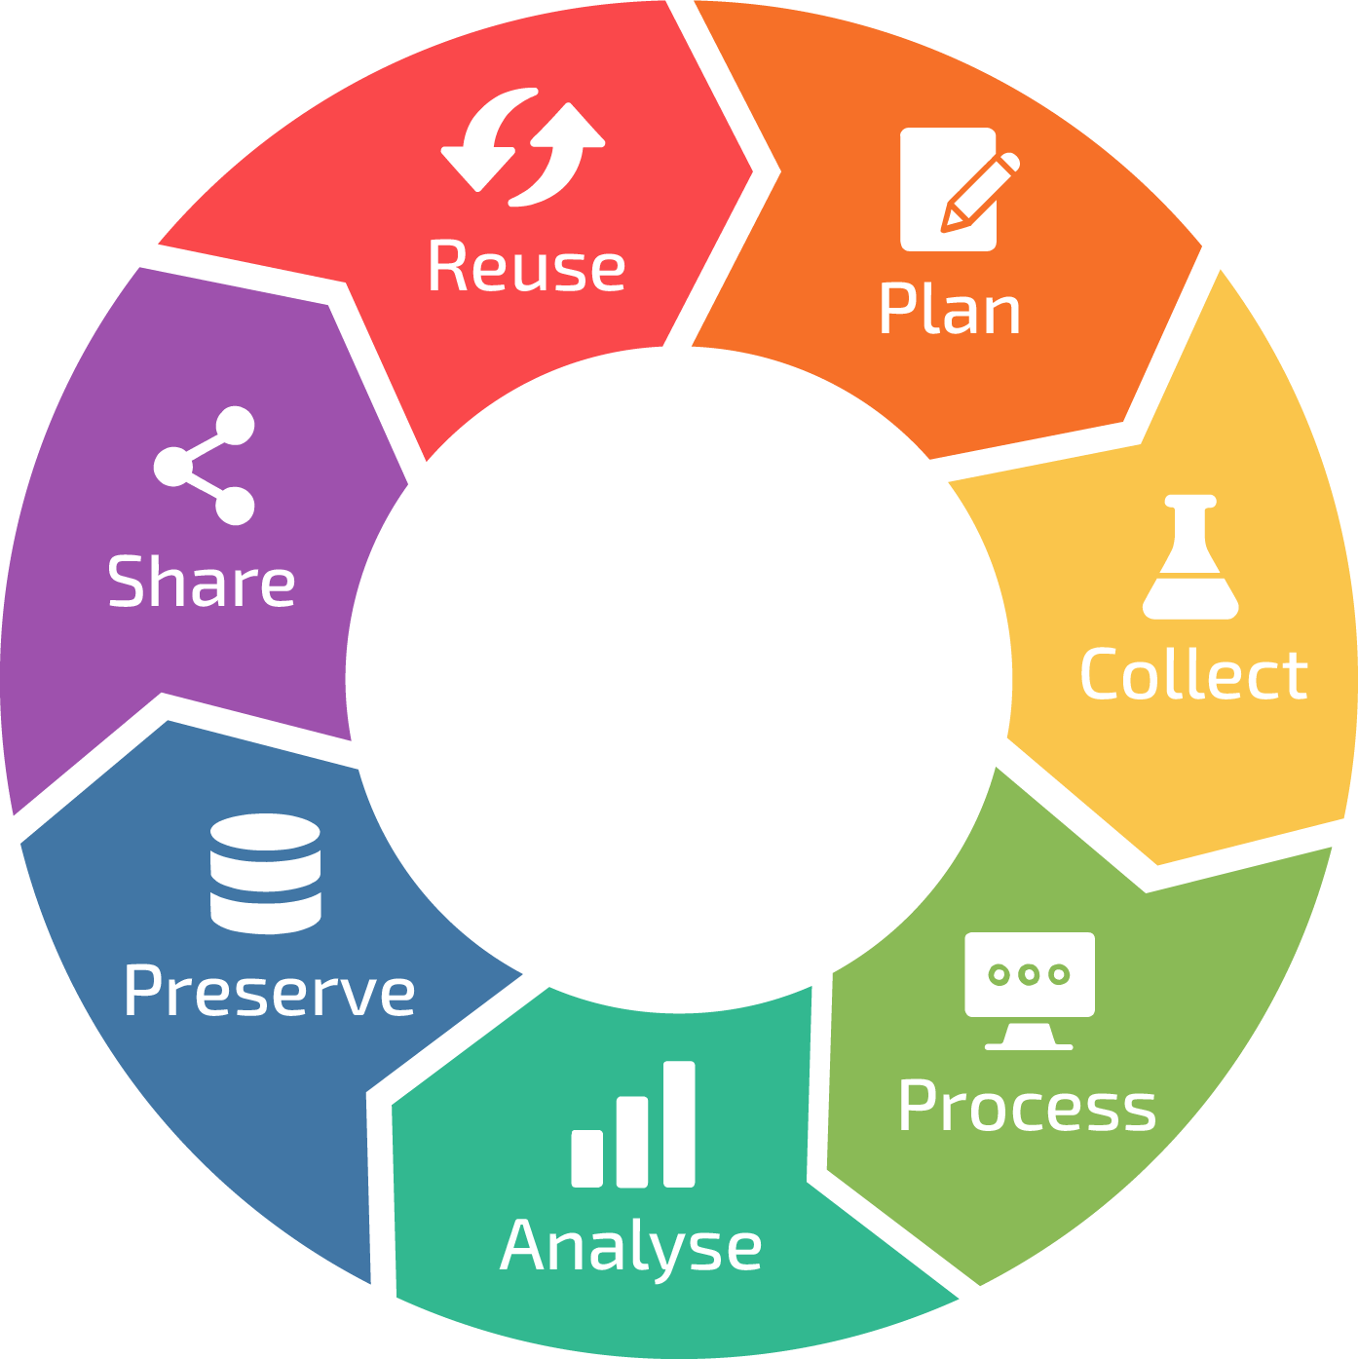
The Data Life Cycle and Corporate Data Usage

Slide 30
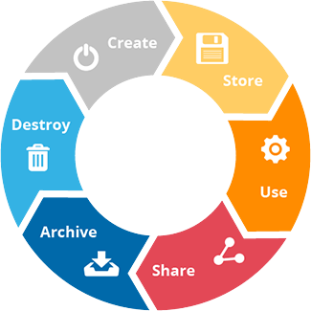
What is the Data Life Cycle?
Data Life Cycle (DLC): The stages that data goes through from its initial creation or collection to its eventual disposal.
It’s a systematic process that ensures data is properly managed, used, and protected throughout its life.
Understanding the DLC is crucial for organizations to harness data effectively and comply with regulations.
This Photo by Unknown Author is licensed under CC BY-ND

Slide 31
Stages of the Data Life Cycle
1. Create / Collect
Collect data from various sources.
E.g., customer interactions, sensors, transactions.
2. Store
Store collected data in databases, data warehouses, cloud storage.
3. Use
Process stored data, transforming it into a useable format.
4. Share
Share the insights derived from data across the organization and/or with external stakeholders.
Analyze processed data to extract insights, identify trends, and support decision-making.

Slide 32

Stages of the Data Life Cycle
5. Archive
Store data that is no longer actively used for the long term, typically for legal, historical, and recovery purposes.
6. Destroy
Destroy or delete data that is no longer needed. Data should be securely destroyed to protect sensitive information.
How do you think the DIKW model aligns with these stages?
Where is information, knowledge, and wisdom created in this life cycle?

Slide 33

Why we care about the DLC
1. Efficiency:
Proper management of data throughout its life cycle ensures that data is always available when needed, reducing delays in decision-making.
2. Compliance:
Adhering to the data life cycle helps organizations comply with legal and regulatory requirements, such as data protection laws.
3. Cost management:
Effective data management reduces costs associated with storage, processing, and data breaches.
4. Security:
Managing data through its life cycle ensures that sensitive data is protected from unauthorized access and misuse.

Slide 34

Case study: Data-driven decision-making
Amazon uses vast amounts of data to optimize its supply chain, personalize customer recommendations, and improve delivery efficiency.
Example: Amazon’s predictive analytics allow it to anticipate customer orders and stock items in warehouses close to the customers before they even place the order!
Impact: Reduced delivery times, greater customer satisfaction, and competitive edge in the retail market.
Amulyaa Vaisshnavi Kalvakuntla (2023). How Amazon Uses Data Analytics to Deliver Packages Faster.
Greg Bensinger (2014). Wall Street Journal. Amazon Wants to Ship Your Package Before You Buy It.

Slide 35
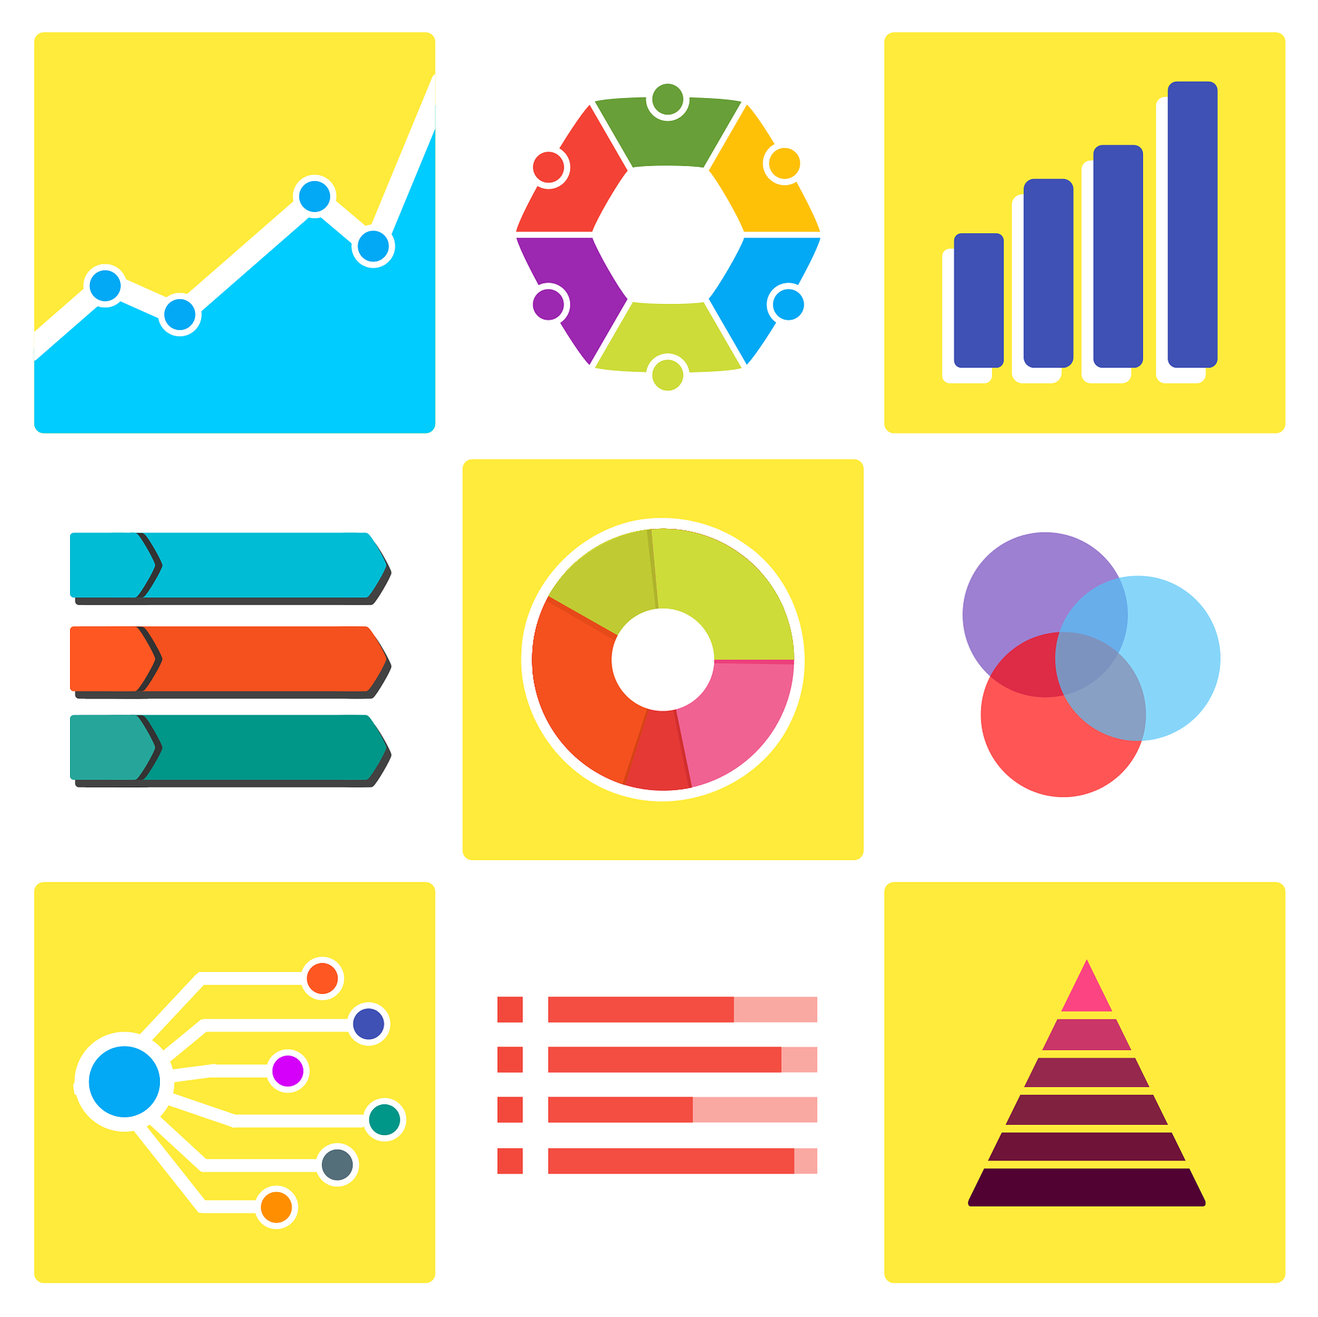
Storytelling with Data

Slide 36

Storytelling with data
Incorporating data visualizations into stories can make data more engaging, understandable, and memorable.
Narratives simplify complex trends, making them easier to understand and interpret.
Stories are persuasive!
This Photo by Unknown Author is licensed under CC BY-NC-ND

Slide 37
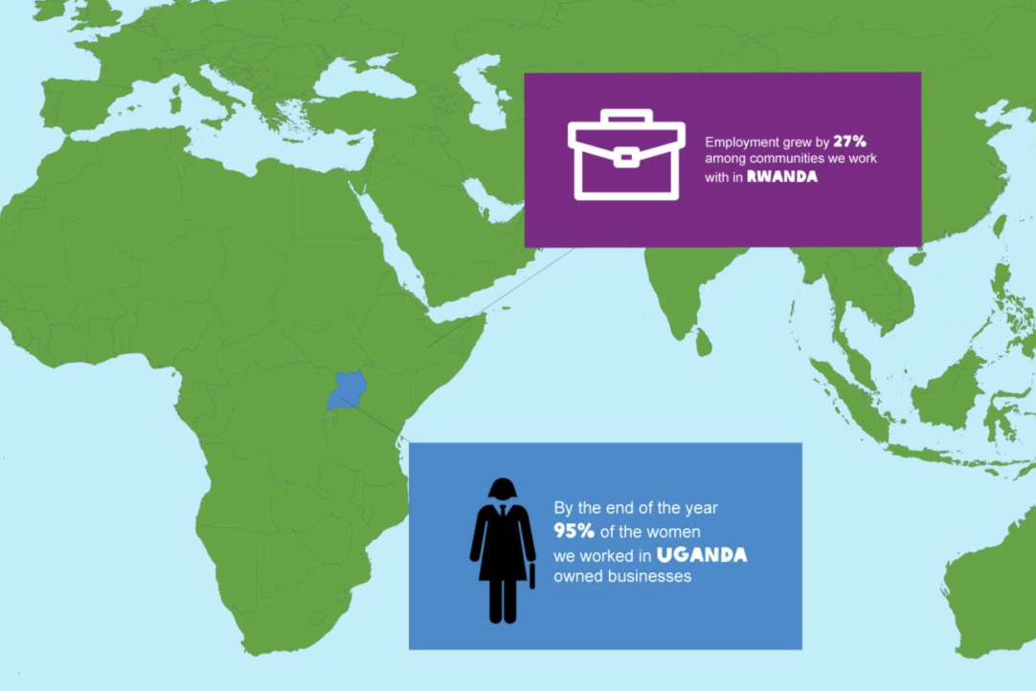
Storytelling with data: Elements of a data story
A clear storyline guides the audience through the data.
Visualizations support the narrative, highlighting key insights.
A call to action compels the audience to act on the information.
Above: NGO Oxfam Ireland track and report on their goals using an interactive annual impact report to tell their year’s story with data.

Slide 38
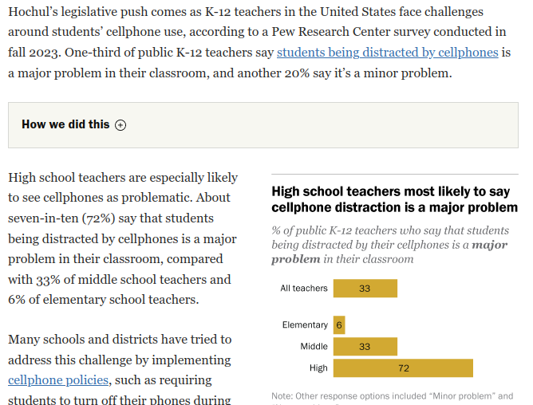
Storytelling with data: Example
The article tells the story of K-12 teachers “fac[ing] challenges” concerning student cellphone use.
The charts help us see why certain cellphone policies may be implemented.
Above: A June 2024 Pew Research article tells the story of how smartphone use is perceived by teachers and students in public schools amidst K-12 teachers’ challenges with student cellphone use.

Slide 39



Storytelling with data: Best practices
Keep it simple
Use consistent visuals
Focus on storyline
Avoid overwhelming your audience with too much data; focus on key insights.
Ensure your visualizations are clear and aligned with the narrative.
Make sure the data supports the story, not the other way around.

